Slide 1


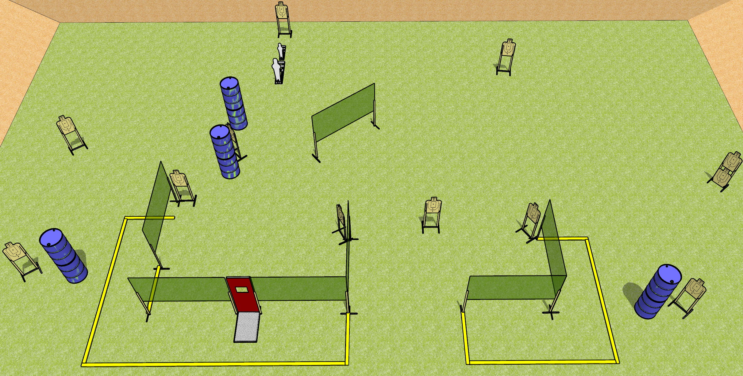
 | Dothan Gun Club – USPSA Match Get Out There Course Designer : Drew Coleman
Round Count 26 rounds 12 USPSA 1 pepper, 1 mini
Equipment List 4 medium fault lines 12 wall feet Pull cord prop

Slide 2
Get Out There
Written Stage Briefing
Get Out There is a 26 round, 130 point, Comstock course of fire. There are 12 USPSA targets and 2 steel. The best 2 hits on cardboard will score, and steel must fall to score.
Handgun start position is anywhere inside the shooting area, wrists below belt. Handgun is loaded and holstered.
PCC start position is anywhere inside the shooting area, stock on belt. Loaded carbine is held with both hands, safety on.
On the audible start signal, engage targets as they become available from within the shooting area.

